Slide 1
California Structured Decision Making® Model Advanced Supervisor Training
Notes:
Welcome and introductions.
Note to trainer: Welcome participants back for Day 2 or Module 3 of Supervisor Training. If trainees are returning after a period of time, check in with participants about any questions or comments regarding new skills they have tried since Modules 1 and 2.
Review the agenda.
If this session is not consecutive with previous sessions, begin again with title slide, welcome, introductions, and training goals.

Slide 2
Training Goals
Supervisors will:
Increase expertise in Structured Decision Making® (SDM) practice in order to serve as resources for their staff;
Learn ways to integrate SDM® assessments and decisions into key supervisory processes; and
Gain knowledge and skills to help motivate workers in their units to contribute to better outcomes through quality SDM implementation.

Slide 3
Key Themes of Supervising SDM® Practice
SDM tools are prompts for practice that support shared assessment and decision making in partnership with families.
People support what they have a hand in creating: Use of reflective inquiry supports professional skill development.
Relationships matter: Effective interactions/relationships between supervisors and caseworkers support effective practices/relationships between caseworkers and family members.
Notes:
Say: Effective supervision and coaching of SDM practice skills involves helping caseworkers to engage effectively with families in using the framework of the SDM assessments to conduct balanced and thorough assessments that support good decisions.
Many of the skills caseworkers can use to engage and effectively team with families can be modeled within the supervisory relationship.
As we discussed in Module 1, supervisors can engage in case consultations using the “Voice of SDM” assessments to help caseworkers enhance critical thinking and guide decision making.
Effective engagement depends on true collaboration and transparency. Use of appreciative and reflective inquiry in supervision encourages caseworkers to “think through” complicated family situations and develop effective solutions and interventions. Use of solution-focused supervision also models essential casework engagement skills for workers.
Building effective relationships between caseworkers and supervisors ultimately results in helping caseworkers develop these relationships with family members.

Slide 4
Roundtable
What are some supervisory strategies for:
Supporting caseworkers in using the SDM model to guide decisions that result in the best outcomes for families?
Helping caseworkers develop strong immediate safety plans with families?
Encouraging caseworkers to use the structure of SDM assessments in their daily casework?
Notes:
Note to trainer: You can use this time to allow participants to reflect upon various SDM issues in their unit at the start of each module. The amount of time and specific exercise can vary. It is designed to be flexible so that you can individualize sessions. If sessions are being held back-to-back, you may do a brief check-in. If the group is reuniting after weeks, you may check in to see how things have gone since last time and whether they’ve tried any of their new skills. You can use the time to recap what has been covered and/or include an exercise of your own choosing that would highlight a specific issue for the group you are training.

Slide 5
SDM® Tips
P. Guide
59
Notes:
We have started a tip sheet to collect the great insights and ideas supervisors have so we can share these with other supervisors. On page 59 in your manual, you will find a few good suggestions.
Note to trainer: Ask experienced supervisors in the room if they would share an idea that really helped them implement the SDM system better, or how the SDM system helped them strengthen practice in their unit. If you have experienced supervisors, ask them what they wish someone had told them long ago. If you have new supervisors, ask them what, as workers, they wish their supervisors had done related to strengthening SDM implementation. Write these on flip charts. If you are willing, email good ones to pcordero@nccdglobal.org, and we will continue to grow this tip list, organizing it into topics as it grows.

Slide 6
Process of Implementation
Improved outcomes
Time
Guide decisions
Accurate completion
Complete assessments
Family engagement
Notes:
Keep in mind that every worker will go through a developmental process as he/she learns to use the SDM assessments. The foundation is family engagement skills. Without this foundation, it is unlikely that workers will ever succeed in getting accurate information to complete assessments, nor will they succeed at engaging families in appropriate services.
The first stage of SDM competency is determining which SDM assessment to do on which family and when.
The second stage is gaining competency in applying definitions accurately to a variety of unique circumstances. This also includes writing clear and concise narratives that support the assessments.
The third stage is really settling in to let the SDM system guide decisions. When this takes place, outcomes are very likely to improve.

Slide 7
Focus of Supervision and SDM® Practice
Managerial/ administrative
SDM Connections
Engagement and
interviewing
“Voice of SDM” in group supervision and case consultation
Effective safety planning
Behaviorally focused case planning
Supporting use of reassessments in casework
Case review
Supportive
Developmental
Notes:
In today’s module, we will go over several areas of focus in supervision and discuss implications for SDM practice. Throughout, let’s keep in mind that our goal is to help workers develop their own critical thinking and expertise in the SDM model and practices and to model ways of interacting with families.
First, set the expectation with caseworkers that SDM assessments are an integrated part of their daily casework with families. Model how caseworkers can organize interviews, family meetings, and monthly casework visits using the structure of SDM tools. Using these structures supports balanced and consistent assessments as well as transparent and shared understanding and decision making with families. Set the expectation that they incorporate evidence of SDM practice into case notes and court reports.
Second, as we learned in Module 1, become “the Voice of SDM” (using the structure and definitions of the SDM assessments) during all case consultations and group supervision, whether in the office with staff or in meetings with families.
Third, help and support caseworkers in developing the important skills of safety planning and immediate safety plan writing.
Fourth, help and support caseworkers in learning the important skills of developing family-focused and behaviorally specific case plans with families based on results of the family strengths and needs assessment (FSNA).
Fifth, help your caseworkers understand how their monthly casework can frame the way they work with families who are trying to meet their case plan goals. Encourage caseworkers to share SDM reassessment components with families at the start of this important work together.
Finally, help workers develop their skills in reflecting their good practices with families in their referral and case records and court reports. This can be accomplished by developing regular habits related to referral/case reading and using case reading results in supervision with caseworkers to coach their practice development.

Slide 8
Sharing SDM® Assessments With Families
Encourage caseworkers to:
Use SDM assessments to prepare for interviews and family team meetings to ensure the gathering of information relevant to a key decision point.
Share the purpose, structure, and results of the SDM assessments (not the tools themselves) with family members to support shared understanding, decision making, and planning.
Notes:
SDM assessments can provide effective supports for ensuring consistent and complete information gathering at key decision points. As a supervisor, you can help caseworkers use the appropriate SDM assessment tool to prepare questions and agendas for interviews, family meetings and monthly case visits.
True family engagement requires transparency about caseworker processes to guide decisions with families. While sharing the SDM assessment form with families is not recommended, informing family members of the purpose, structure, and results of SDM assessments allows family members to participate in decision making and planning.

Slide 9
Things to Try
Work with a caseworker to prepare for an interview, family meeting, or monthly contact using an SDM assessment.
Coach/role-play with a caseworker about how to explain the purpose and process of assessment at key decision points.
Coach/role-play with a caseworker about strategies for explaining results of an SDM assessment.
Notes:
Here are a few activities to try with your caseworkers.
Work with a caseworker to prepare for an interview, family meeting, or monthly contact using an SDM assessment.
Coach/role-play with a caseworker about how to explain the purpose and process of assessment at key decision points.
Coach/role-play with a caseworker about strategies for explaining results of an SDM assessment.

Slide 10
The “Voice of SDM®” in Group Supervision and Case Consultation
Facilitate any group consultation about/with families using the structures and definitions of the key SDM assessment.
Combine “Voice of SDM” with other mapping and consultation frameworks to enhance critical thinking.
Notes:
Bringing the SDM assessment model into daily practice can be as simple as using your supervisory coaching and support roles to model thinking through complex family situations using the structures and definitions of SDM assessments. When a supervisor uses the “voice of SDM” in case consultation and individual and group supervision, whether in combination with mapping and consultation frameworks, the result is enhanced critical thinking and balanced and rigorous assessments.

Slide 11
Critical Role of the Supervisor in Group Supervision
Solution- Focused Climate
Coaching
Mapping
Notes:
The critical role of the supervisor in group supervision involves setting the tone/culture of the process by being clear about purpose and desired outcomes, engaging in respectful dialog that results in shared learning, and modeling behaviors that encourage caseworkers to seek help from and consult with one another.

Slide 12
What is group supervision?
A learning environment.
It is a place to:
Think
Learn
Reflect
Collaborate
Offer mutual support
Grow
Notes:
In summary, a supervisor can grow the practice and critical thinking skills of staff by regularly engaging in this group process.

Slide 13
A Dialogue Structure for Any Conversation
Key question to guide each stage of the process | Stage of conversation
Overall, why are we meeting today? | Purpose
Is there anything that might pull our attention away from our focus today? (naming differences and impact fits here too) | Context
How do we want to work with each other? | Group Agreements
Is everyone here who should be? If not, what should we do to get them here? | Network/Stakeholders
What do we want to walk away with today, from this meeting? (a plan, list, decision, etc.) | Desired Outcome
What do we want to talk about? (could be actual safety mapping, safety circles, case consultation, etc.) | Content
What steps do we need to take from here? Who does what? By when? Next meeting date? | Next Steps
What worked? What should we do differently next time? | +/∆ Feedback
Notes:
Adopting and practicing the use of a facilitation structure can be helpful in the process of case consultation and group supervision.

Slide 14
Safety Planning
Notes:
Caseworkers need to master developing rigorous safety plans that enable the family and their support network to take actions that immediately control safety threats and prevent protective placement. Supervisory oversight and support of caseworker safety planning with families is essential for child safety.

Slide 15
Exercise
Think about the best safety plan you have written or seen.
Think about a safety plan that you struggled with or was not effective in controlling danger.
What did you learn from each one?
Notes:
PURPOSE
Short exercise to help the group start generating some of the core concepts of the framework.
Visualize one more specific case.
Allow another 30 seconds to think about a specific example.
You won’t have to share this example out loud.
Large group debriefing on lessons learned.

Slide 16
Key Supervisory Strategies to Support Safety Planning Skills
Understand the link between SDM safety assessment and safety plans.
Know the essential elements of a well-written safety plan and how to write a rigorous plan.
Provide support to caseworkers in the field related to identification of support networks and immediate safety interventions.
Provide opportunities to write/review and improve safety plans during unit meetings.
Notes:
The SDM safety assessment structure provides the framework and process for safety planning. When one or more safety threats are present in a household, steps must be taken to assess and use actions of protection and household and support network strengths to build a set of immediate actions that can control the safety threat until it is resolved.
Supervisors can support the process of information gathering, critical thinking, and planning with family regarding the immediacy and severity of the caregiver’s behaviors and the resulting danger (safety threat) to a child or children while caseworkers are in the field working with families. It can be difficult to think through options for safety interventions in the midst of family crisis, and a supervisor’s support in asking good questions and using the framework and SDM safety assessment definitions can provide needed support.
Supervisors should consult with caseworkers in the field to ensure that safety plans are sufficient to control immediate danger, families and their networks have been involved in and agree to their plans, and the way plans are working can be monitored in a reasonable way.
Finally, in addition to supporting caseworker safety planning skills, supervisors should support caseworkers in strengthening their skills in writing strong safety plans during non-crisis moments, such as providing time for practice writing and/or reviewing and improving safety plans during a unit meeting.

Slide 17
Essential Elements of a Well-Written Safety Plan
The number of safety threats from the assessment that meet the threshold for removal
Specific behavioral description of actions/inactions of legal parent that result in specifically described impact on the child that needs to be controlled
A specific set of actions/changes that occur immediately so the present danger is controlled
A way to monitor whether or not the plan is working
A specific time limit for the plan to be in effect
Signatures of agreement
Notes:
Your county has developed a customized safety plan format for use by workers based upon key elements of a well-written safety plan.
The safety plan should:
Link each identified safety threat to a household-specific behavioral description of the caregiver action/inaction that results in danger to the child;
Include a specific set of immediate actions by family members, network members, and others that are sufficient to control and monitor the danger; and
Specify time limits for review and updating of the plan and signatures (your signature may be verbal while the worker is in the field) that represent agreement of the plan by at least one legal caregiver, support network members, and the agency.

Slide 18
Hot Spots in Safety Plans
“Caregiver promises” are the only intervention
Lack of behavioral description, mentioning only caregiver action/child impact
Safety planning without a legal parent
Creating a safety plan for the family rather than with
Domestic violence cases
Violating parental rights and due process
Writing a risk management plan
No time limits
No fail-safe measures
Notes:
Supervisors can support more rigorous safety plans by helping to spot and address some of the “hot spots” in safety plans. These might include:
The only action to control a safety threat involves a caregiver “promise” to avoid the behavior that led to the safety threat. Address this issue with one support network member who can continuously monitor and support the caregiver’s behavior for the period of the safety plan.
A lack of behavioral detail regarding how the caregiver’s action or inaction endangers the child. For example, the statement “parent is using drugs” lacks detail about impact on child safety. Supervisors can use reflective inquiry and SDM safety threat definitions to support information gathering and critical thinking to help caseworkers concretely describe the danger and the safety intervention.
Developing safety plans without the involvement or agreement of at least one legal parent.
Creating a safety plan for a household, rather than involving family members in developing and designing the plan.
Failing to plan for the safety of both an abused parent AND children in situations where intimate partner violence is present.
Developing safety plan interventions that may violate a parent’s rights related to access to a home or contact with a child without their consent or opportunity to be heard.
Writing a safety plan when no safety threat is present.
Writing a safety plan without a time limit or way to monitor its effectiveness.

Slide 19
A Look at Two Safety Plans
Notes:
Note to trainer: Refer participants to the safety plan examples in the workbook and ask them to compare and discuss differences.

Slide 20
The SDM® FSNA Informs Case Planning
Notes:
By completing the safety and risk assessment, we learn a lot about a family -- enough to determine whether a case should be opened. But, typically, what we learn is focused on the information needed to make that key decision: the presence of threats and whether a short-term plan is controlling those threats and the likelihood of a future event that will have a negative impact on the children in the home. Now is the time to work with the family to understand what lies within caregiver and family functioning that impacts both safety and risk, as well as what the child’s needs are. That is the role of the family strengths and needs assessment (FSNA).
This assessment helps to identify and create agreements about what to address in a case plan. The social worker must identify priority areas of need as the focus of efforts to improve family functioning and child safety.
Many CWS families have multiple needs, but not everything can be changed at once. Where to start?
The FSNA also ensures that we see not only the needs of families, but also their strengths. Knowing both the priority needs and strengths prepares us to develop a case plan in conjunction with the family.
Unlike the risk assessment tool, which looks only at statistically relevant items, the FSNA provides a comprehensive overview of family functioning in areas related to their ability to parent and protect their children. Because this tool is completed at the close of an investigation, it anticipates knowing more information about a family.
California workgroups worked very hard to ensure that each item has a potential strength response. Each item has four levels that correspond to a strength (a items), an absence of a need (b items), a minor need (c items), and a severe need (d items). In the FSNA’s most recent revision, these items are connected to identified safety threat and risk items related to reason for involvement.
Supervisors can support and strengthen caseworker practice related to involving family members in assessing their underlying needs and strengths.

Slide 21
Explain the FSNA to the Family
Comprehensive assessment of caregiver, family, and child functioning as it relates to safety and risk
Identifies the most important needs that relate to safety and risk
Identifies the most important strengths that can be used to build lasting safety
Helps us reach agreements about the focus of the case plan
A conversation, not a test!
Notes:
Encourage your caseworkers to develop and use a family-friendly explanation of the FSNA purpose and process. Set the expectation with caseworkers that the FSNA conversation with the family is an essential part of creating a behaviorally focused case plan that effectively addresses underlying needs related to safety threat and risk in the household.

Slide 22
Steps for Developing a Case Plan
Pre-contact preparation
Construct shared danger and goal statements
Identify and involve the network
Break down goal statement into a set of key behaviors
Identify formal and informal activities/ services that support development of new behaviors
Monitor, adapt, and strengthen
Orient the family to the task and engage in FSNA conversation
Develop a progressive visitation plan
Document the plan
Notes:
Note to trainer: Refer participants to their workbook handout that provides a suggested framework for developing case plans with families. Ask them to discuss strategies for encouraging caseworker use of this process and the challenges that caseworkers may face in fully engaging families in this process.

Slide 23
Supporting Use of the SDM® Model in Ongoing Casework
Notes:
We are going to take a few moments to consider strategies for helping caseworkers use SDM assessment results to create shared agreements with caregivers about measuring their progress over time.
In addition, we want to talk about strategies for helping caseworkers to recognize and use the framework of the SDM reassessment in their ongoing contacts with caregivers and children/youth. This will help to assess and document case plan progress and family support network development, which are key to ongoing child safety.

Slide 24
Working With Families During Reunification
Keep a sense of urgency: Be clear about timelines for decision making.
Orient the parents to shared understanding of safety threats, risk, and the process for evaluating change.
Expand the family’s support network.
Create planned, purposeful, progressive contacts and visits that take family wishes and culture into account.
Create opportunities for parents to demonstrate “acts of protection” during visits.
Expect challenges and the “uneven path.”
Notes:
Here are some tips for developing a productive partnership with families to support reunification.

Slide 25
Orienting Families to the Reunification Process
Explain the process (why, what, how).
Review and clarify the harm/danger statements.
Review and clarify the safety goal.
Talk with families about …
Demonstrating Safety
Developing the Network
Reunification Reassessment
Think together: How can the parent demonstrate acts of protection during this time?
Who cares about the child and parent?
How can we get them involved?
Share the danger statements and safety goals.
Starting risk level
Progress toward goals
Actions during visits
Changes in safety
Notes:
Encourage caseworkers to use the “Voice of” the SDM reunification reassessment in combination with prior efforts to create clear understanding of harm/danger as well as the presence of safety.

Slide 26
Staying Focused: The SDM® Connection
Some actions
More actions
Regular actions
Reunification Reassessment Key Questions:
Reduced risk level = low or moderate
Includes no new reports and progress toward case plan goals = meaningful behavior change
Visitation frequency and quality = consistent demonstration of acts of protection during visits that mitigate the danger
Safety threats resolved = safe or safe with plan now
Notes:
The reunification reassessment tool can help to orient the family to the process for measuring change and making decisions about when to reunify.

Slide 27
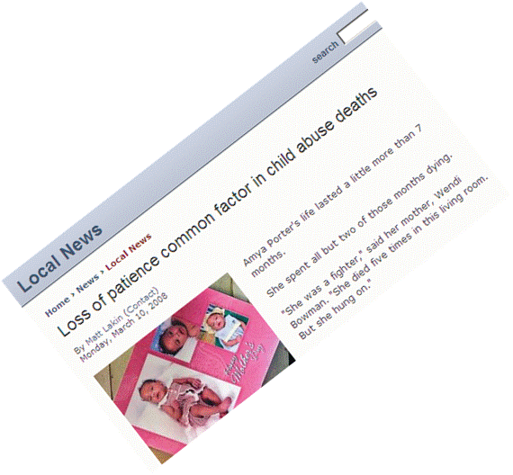
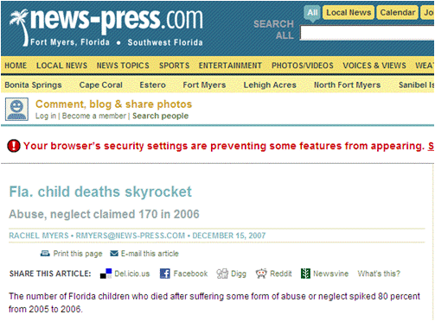
Critical Case Reviews
Notes:
Note to trainer: This slide will gradually display a series of headlines without requiring any click. You can begin talking and the headlines will appear as you talk.
For most of us, most of the time, this next section is like the third rail of child protection. No one wants to think about a family we worked with--a child we knew--becoming a headline. But it happens over and over. We have to remember that newspapers are in the business of selling papers. When they print distortions or half-truths, when we cannot share our side of the story because of confidentiality, it’s easy to get frustrated and demoralized--on top of the awful feeling of wondering if we could have done something to protect that child. In this section, we will present a way to incorporate an examination of SDM assessments into critical case reviews. These should not be searches for justification or rationalization, nor searches for a scapegoat. They should be searches for what we can learn about what happened. If we reach a conclusion that, even if not handled perfectly, the case was handled as well as it could have been at least we know we did our best. If we learn that the case was not handled correctly, we need to learn from our mistakes. The cost of not learning is too high.

Slide 28
Prompts for Critical Case Review
Child death/
near death
Headline
Political pressure
You know something went wrong
Notes:
The term “critical case reviews” may have a specific, official meaning in your county. In this training, we mean it generically as a way to search for answers when something seriously goes wrong. Many things can prompt a critical case review: A child dies or almost dies; there is a negative headline; the county supervisor calls, demanding action. Most often, external forces cause critical case reviews. We also need to be willing to look at ourselves when no one else is looking. This approach can be used regardless of the prompt.

Slide 29
Types of Critical Case Reviews
Formal
Highly structured
Process may be specified in policy or law
May involve outside reviewers
Stay clear unless asked
Informal
For your own knowledge
NOT during someone else’s formal critical case review
Notes:
Formal critical case reviews may be regulated in your jurisdiction. They can be highly structured, with the process dictated by policy or local law. Outside reviewers may be involved. If a formal critical case review is in process and you are not part of it, STAY CLEAR. Unless you have related business, stay out of the files and don’t ask questions. The stakes can get pretty high, and you do not want to have even the appearance of tampering with a file.
If you are involved, you can integrate this approach if approved by whoever is leading the effort. You may be asked to report to an investigating body. See if you can use this review process to prepare for your interview or deposition. It will help organize your thoughts.
When there is no official critical case review, but you want to know for yourself what happened, you can use this approach.

Slide 30
Incorporating SDM® Assessments Into Critical Case Reviews
P. Guide
71
Over entire span of contact with family:
Referrals
Were SDM assessments done?
Were they done accurately?
Were recommendations followed or explanations given for alternatives?
Cases
Were SDM assessments done?
Were they done accurately?
Were recommendations followed or explanations given for alternatives?
Notes:
Critical case reviews cover the entire span of contact with a family, from the very first referral to the most recent contact. During this span, there may be numerous referrals. A family may never have a case opened, or there may have been multiple cases. We will take referrals one by one, and ask a few basic questions: Were the required SDM assessments done (on time, etc.)? Were they done accurately? And was the action taken consistent with the result?
Then we will take cases one by one and ask the same questions. Look on page 71 for specific key questions. Note that similar questions get raised during conferences BEFORE a decision is made, approvals just AFTER a decision is made. The better you do at earlier points, the less you sweat at a critical case review.

Slide 31
Steps
P. Guide
72
Create timeline of key decision points.
Look for expected SDM assessment for each point.
Review each assessment found for accuracy (narrative vs. definitions).
Was recommended action taken for each assessment found?
Notes:
Case files can be pretty big and disorganized, which is why approaching this task with a system is helpful. For each referral and/or case, it helps to lay out a timeline for key decision points (e.g., referral date, first contact, case open date, case plan date). From this, you can calculate which SDM assessments should have been completed and when. For the assessments you find, carefully examine each item score compared to the narrative and the definition. Was it accurate? If not, did it change the recommendation? Finally, did the worker act on the recommendation (or the recommendation that would have been made had the assessment been done correctly)?

Slide 32
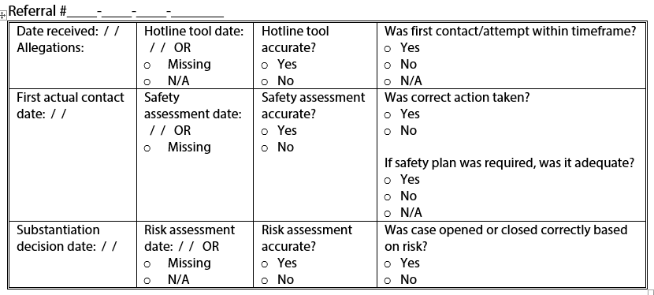
Referral Segment
P. Guide
73
Notes:
You will find a sample of this worksheet in your workbooks. This is not a new required form--you don’t ever have to use it. But, if you need to do a critical case review, you may find it helpful for organizing the process.
Each referral has three rows and four columns of information. Start by entering the referral number for each referral you locate. Do one for every referral on the family, including any adult living in the household at this time even if he/she was part of a different household at the time of the prior referral. You can find this information by searching for client IDs in SafeMeasures. That is a handy way to do it, as you can search for each referral and get a lot of this information from the referral history page.
(CLICK)
For each referral, start by completing Column 1 with the date received, the first contact date, and the date the substantiation decision was made.
(CLICK)
Now move to Column 2. Is there a hotline tool for this referral? If yes, enter the date. Is it the same date as the date received? Do you find a safety assessment for this referral? Mark the date. Is it the same date as the first contact or is it missing? Is there a risk assessment? If so, enter the date of completion. Is it within 30 days of the first contact? If there is no risk assessment, mark “Missing” or “N/A”--if the referral was unfounded.
(CLICK)
Next compare the hotline tool to the screener narrative. Was it accurate?
Do the same for the safety and risk assessments. This step will take the most time, especially if the narrative is not organized well. When you begin to look backward at a few critical case reviews like this, you will begin to appreciate what you wish workers would do on every referral.
(CLICK)
Finally, in the last column we assess whether the correct action was taken. Was the first contact within the required timeframe? Mark “N/A” if evaluated out and it should have been evaluated out. Mark “No” if it was evaluated out but should have been assigned. Next, was the child placed or not placed in accordance with the safety assessment? If a safety plan was required, was there an adequate safety plan? Mark “N/A” if child was safe or unsafe. Finally, were recommendations to promote or not promote followed? (Use what SHOULD have been the recommendation if the assessment was completed incorrectly).
Do this for as many referrals as you have. It is helpful to highlight or circle in another color the spots that show policy was not followed.

Slide 33
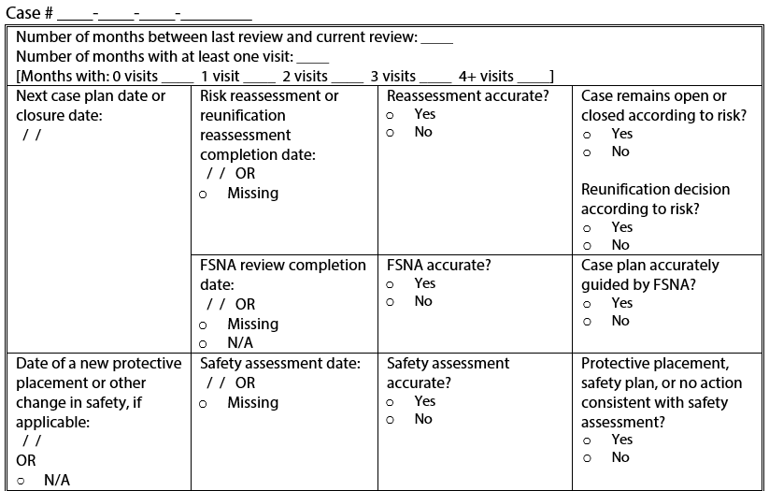
Case Segment
P. Guide
74
Notes:
Do one for every case for the family. A case can go on indefinitely—just add another page.

Slide 34
Tips
Use SafeMeasures™ history pages to get quick comprehensive details about each case and each referral.
Use webSDM to quickly gather assessments from each case and each referral.
Notes:
Critical case reviews often are very time consuming, labor intensive, and complicated. WebSDM is helpful for getting a quick list of SDM assessments for each case or referral. You can click directly into the assessment itself.
Using the SafeMeasures History page for referrals or cases also can simplify this process.

Slide 35
Critical Case Review
Notes:
Even with help, these reviews can take a lot of time. We will try a relatively small example today.

Slide 36
Critical Case Review Handout
Critical Case Review Handout
Critical Case Review Forms
Use blank critical case review grids.
Review materials provided.
Enter each referral and each case.
Enter dates in Column 1.
Determine whether SDM assessments were completed. (2)
If so, were they accurate? (3)
If so, was correct action taken? (4)
Notes:
Break into teams of two.
Note to trainer: Distribute critical case review handout and blank forms (each participant should receive two blank referral forms).
These case files will be collected at the end of class and reused, so please do not write on them. Tab sections and/or make notes if you like with the Post-its at your tables. The SafeMeasures and SDM printouts are from an actual case, but the narrative is entirely fictional. Nothing bad actually happened in this case. All identifying information has been stripped. Instead of names and birthdates, you see relationships and ages, so you can tell when the same person is referenced. The ages stay constant as of August 2008. Where a staff person is listed, you see number designations. When the same number is used, it is the same worker. When a different number is used, it is a different worker.
This example never had a case open, so we will work only with referrals. Complete as many referral grids as you need based on the number of referrals. You can work any way you want, but most people find it easiest to complete the grids by columns rather than rows.
You have 30 minutes for this exercise. Do not worry if you don’t finish. This is a learning experience, not a time to prove we can do it in 30 minutes.

Slide 37
Debrief
Notes:
Note to trainer: Refer to answer sheet.
Let’s look at Referral 1.
Was first contact attempt within timeframe? Though actual contact was late, an attempt was made within 10 days.
Safety assessment accurate? Narrative does not meet definition for hazardous living conditions.
Correct action? Though worker marked as conditionally safe, which requires a plan, the fact that there really was no safety threat means plan was not needed.
Case open? Had there been a safety threat, case opening would have been required.
Let’s look at referral 2.
Note to trainer: Ask participants if they had anything different. Discuss differences.
Hotline tool: N/A is marked rather than missing because the SDM system did not have a screening tool in 2004. The response priority was not required since it was evaluated out.
Let’s look at the third referral. Ask participants if they had anything different. Discuss differences.
Let’s look at the fourth referral.
Note to trainer: Ask participants if they had anything different. Discuss differences.
Hotline accurate? First box should be “no.” There is not narrative to support that child’s developmental level is under 2. However, third box, child’s developmental disability, meets definition to answer “yes” to vulnerability. Result is 24-hour.
Safety: Item 5 should be marked. Parents give conflicting and changing accounts that are inconsistent with injury. Child vulnerability should be marked.
Let’s look at final referral.
Note to trainer: Ask participants if they had anything different. Discuss differences.

Slide 38
California Structured Decision Making® Model Advanced Supervisor Training
Notes:
Welcome and introductions.
Note to trainer: Welcome participants back for afternoon of Day 2 or Module 4 of Supervisor Training. If trainees are returning after a period of time, check in with participants about any questions or comments regarding new skills they have tried since they were last together.
Review the agenda.
If this session is not consecutive with previous sessions, begin again with title slide, welcome, introductions, and training goals.

Slide 39
Roundtable
What are your supervisory practices in ensuring quality referral/case documentation?
How do you use the results of your case review to support worker skill development?
Notes:
Note to trainer: You can use this time to allow participants to reflect upon various SDM issues in their unit at the start of each module. The amount of time and specific exercise can vary. It is designed to be flexible so that you can individualize sessions. If sessions are being held back-to-back, you may do a brief check-in. If the group is reuniting after weeks, you may check in to see how things have gone since last time and whether they have tried any of their new skills. You can use the time to recap what has been covered. You also can include an exercise of your own choosing that would highlight a specific issue for the group you are training.

Slide 40
Supervisory Case Reading
Case Reading Manual
Notes:
Now we will discuss the role of supervisory case reading in assessing and supporting quality implementation of SDM assessments.

Slide 41
Continuum of Quality Assurance Opportunities
Primary Prevention
Mini-training, cheat sheets, supervisory modeling
Primary Intervention
Approvals, addressing mistakes, reviewing overrides
Tertiary Intervention
Critical case review
Secondary Prevention
Case conferences and group supervision
Secondary Intervention
Supervisory case reading
Notes:
We already talked about a number of strategies along a continuum of quality assurance as well as some key areas where supervisors can support caseworkers in integrating SDM assessments in daily practice with families. On the left of the slide is primary prevention: things you generally do for everyone before a problem arises in hopes of preventing a problem. Examples would be doing mini unit-level trainings, providing “cheat sheets,” or plastering the word “DEFINITIONS” all over the walls.
Secondary prevention is similar to primary prevention, but with a specific case. An example of this might be routine case conferences.
Primary intervention happens through your role in making approval decisions. The action already has been taken, so if you find a mistake, it’s too late to prevent it. Hopefully nothing bad happened, and you can correct the situation while the lesson is still fresh.
Secondary intervention is what we will learn next. The referral already is closed, or you already finished a review period and are looking backward. Finding mistakes here means it is usually too late to fix that referral or case, but it can be used to teach how to prevent the next one from happening.
Finally, we just learned what could be thought of as tertiary intervention. A very bad thing already happened and all we can do is find out why.
You can intervene at any point. At which point do you want to discover errors in your unit?

Slide 42
Supervisory Case Reading Goals
Manual
1
Improve assessments
Improve narratives
Increase consistency
Improve decision making
Improve practice with families
Notes:
Refer to page 1 in the California Case Reading Manual.
The basic goals of supervisory case reading are to improve how assessments are completed; help workers improve how they write case narratives (more focused and concise, targeted to address only relevant issues); increase consistency in how the SDM system is implemented across workers; improve and strengthen overall decision making; and improve caseworker skills in integrating SDM assessment structures with their daily practice.

Slide 43
Supervisory Case Reading Objectives
Manual
1
Systematic appraisal of knowledge and skill within and across units
Support workers’ integrated use of SDM assessments and enhanced engagement practices with families
Identify opportunities for learning
Identify examples of excellence
Notes:
This slide shows the objectives of case reading.
First, case reading is a mechanism that provides systematic assessment of SDM knowledge and skills within and across units. Secondly, case reading offers opportunities for supporting caseworkers’ integrated use of SDM assessments and enhanced engagement practices with families. It is important to see and communicate to the worker that case reading is an opportunity for learning. Lastly, it is not only a mechanism for learning, but a way to identify examples of exemplary casework.

Slide 44
Using Case Reading Results
Primary Prevention
Mini-training, cheat sheet, supervisory modeling
Primary Intervention
Approvals, correcting mistakes, reviewing overrides
Tertiary Intervention
Critical case review
Secondary Prevention
Case conferences and group supervision
Secondary Intervention
Supervisory case reading
Notes:
Refer to case reading manual page 2.
Case reading results can surface ideas for primary prevention and alert you to issues to look for in case conferences. These results also may point to workers who need closer attention during routine approvals (high-level spot checks).
Finally, once you have done well in the first phases, you have less to fear from a critical case review. Bad events can happen despite our best efforts, but workers who document that the assessment process was done correctly build the support that their agencies need when placed under the magnifying glass.

Slide 45
Not One More Thing!
Why supervisory case reading is achievable:
Small sample of cases
Small section of case
Persistent practice improves performance, which:
Makes case reading go faster
Reduces time spent on fixing things after the fact
Makes for better-prepared workers at conferences
Notes:
It is very difficult to envision yet one more thing to fit into our already-busy schedules. Given that quality assurance is a key supervisory responsibility, case reading is a task that can help you meet that responsibility in a structured and efficient way. It is an achievable task. It is important to remember that we are talking about a small sample of cases, and the focus is on one small section or part of a case.
It also is important to remember that case reading becomes more efficient over time as workers learn to think and conduct assessments with the principles of consistent and accurate decision making in mind. As they learn from case reading results, completing SDM assessments should improve, which will make case reading go faster in the future. As they improve, you also will find yourself spending less time fixing mistakes after the fact. Additionally, workers should be better prepared for case conferences, knowing what types of criteria will be reviewed and which will make the case conference process more efficient.

Slide 46
The Basic Questions
Manual 12
Were SDM assessments done according to policy?
Does narrative match item definitions and is there evidence in the narrative of integrated/enhanced practices?
Did worker arrive at correct SDM recommendation?
Did worker follow the recommendation he/she reached (or provide reason for alternative)?
Notes:
Look at the Intake Reading Tool for an example. Each question has definitions as it applies to each tool.
Note to trainer: Review definitions for a couple of questions.
Click hyperlink (Slide 73) for tips on writing narrative.

Slide 47
Case Reading Considerations
Opportunity to provide balanced feedback about:
Areas of strength. What is working well regarding the caseworker’s use of the SDM model?
Areas of opportunity. What are the opportunities for training, coaching, and skill development?
Areas of demonstrated growth. What does the supervisor observe in case records that shows caseworker progress in skill development since last case review?
Notes:
Take a look at page 4 of the Case Reading Manual regarding supervisory considerations. It is important for caseworkers to learn what they are doing well and how they are growing in addition to what needs improving.
Supervisors who offer concrete and clear feedback to caseworkers by reviewing case records form the foundation for supporting caseworker skill and practice development.
On page 5 of the Case Reading Manual is an example of how this area of the case reading tool might be used.

Slide 48
An Opportunity to Notice Integrated Practices
Take time to notice evidence of enhanced practice in case narratives.
Pages six through 10 of the Case Reading Manual provide some ideas about enhanced practice and the ways narrative may reflect these practices.
Notes:
Case reading provides the opportunity to notice—through evidence in case records—that caseworkers are integrating the SDM model and enhanced practices into their work.
On pages six through 10 of the Case Reading Manual, you will see various enhanced practice strategies that might be incorporated into casework related to specific decision points and evidence that might be included in referral and case narratives that reflect these practices.
This handout might be useful in supporting conversations with caseworkers in your unit regarding integrated practices AND how to reflect these practices in case documentation.

Slide 49
What part do you read?
Case Reading Manual
Intake
p. 11
Phone rings to submission of referral for supervisor approval
Investigations
p. 24
Assignment to investigations to close of referral (or hand off to DI)
Voluntary/Court Intake p. 42
Assigned to first case plan OR
Last case plan to current case plan
FM/FR
p. 49 and 77
Development of case plan
Notes:
Contrast this with the critical case review process, which reviews all dates. Policies for each section are on page 11 (intake), 24 (investigation/assessment), 42 (voluntary/court intake), 49 (FM), and 77 (FR).
Note to trainer: Pick one and review in detail.

Slide 50
The Fine Print
Manual 12
Intake
Is the screener narrative behaviorally specific in relation to caregiver actions and impact on the child?
Was there sufficient detail in the screener narrative to support item selection in both screening and response priority tools?
Was there narrative detail about support network and strengths of the household?
Notes:
A couple of things to note on the intake referral reading tool:
Is the screener narrative behaviorally specific in relation to caregiver actions and impact on the child?
Was there sufficient detail in the screener narrative to support item selection in both screening and response priority tools?
Was there narrative detail about support network and strengths of the household?

Slide 51
The Fine Print
Manual
25
Investigation/Assessment
Is there narrative support for the safety threat, caregiver complicating behaviors, household strengths and protective actions, and protective interventions identified?
Was the safety plan completed appropriately?
Did conditions change, making it necessary to complete another safety assessment during the referral?
If yes, was another safety assessment completed?
Notes:
A few things to note on the investigation/assessment referral reading tool:
Is there narrative support for the safety threat, caregiver complicating behaviors, household strengths and protective actions, and protective interventions identified?
Was the safety plan completed appropriately?
Did conditions change, making it necessary to complete another safety assessment during the referral?
If yes, was another safety assessment completed?

Slide 52
The Fine Print
Manual 43
Voluntary/Court Intake
Is there evidence that the FSNA and case plan were completed in partnership with the family/youth?
Were all priority needs addressed and were strengths incorporated in the case plan?
Are case plan objectives behaviorally descriptive and linked to priority needs?
Notes:
A few things to note on the voluntary/court intake reading tool:
Is there evidence that the FSNA and case plan were completed in partnership with the family/youth?
Were all priority needs addressed and were strengths incorporated in the case plan?
Are case plan objectives behaviorally descriptive and linked to priority needs?

Slide 53
The Fine Print
Manual 50
Family Maintenance
Service period case note review tool
N/A (FSNA)
N/A (safety)
Did conditions change, making it necessary to complete another safety assessment during the referral?
If yes, was another safety assessment completed?
Notes:
A few things to note on the family maintenance case reading tool:
1. The tool offers a chance to review service period case notes for indicators of integrated practice.
2. Under the FSNA section, if the case will close based on risk reassessment and safety, mark not applicable.
3. Under the safety assessment section, if the case is not being considered for closure AND there was no change in safety during the review period, mark not applicable.
4. Two additional questions appear at the bottom of the tool:
a. Should another safety assessment have been completed due to changing conditions; and
b. If yes, was another safety assessment completed?

Slide 54
The Fine Print
Manual 78
Family Reunification
Service period case note review tool
Was the FSNA updated?
Notes:
A few things to note on the family reunification case reading tool:
The tool offers a chance to review service period case notes for indicators of integrated practice.
Remember to determine whether FSNA was updated as required.

Slide 55
Using Results
Manual 2
Strengths-based
Coaching/
mentoring
Supervision
Unit competency building
Performance reviews
Notes:
The primary purpose of case reading is to strengthen caseworker skills and ensure quality implementation. This is best achieved when each caseworker learns what he/she is doing well and what can be improved within an environment that recognizes existing strengths and encourages and mentors growth. Ideas for discussion follow.
Individual supervision:
Go over individual caseworker case reviews on specific cases.
Review rationale for score given.
Highlight successes.
Review definitions and/or policy that may have been misunderstood.
Based on caseworker feedback and pattern of reviews over time, consider whether any knowledge/skill/attitude issues are suggested.
Set performance goals.
Unit supervision:
If similar issues are observed across several caseworkers, consider addressing the issue in a unit meeting. For example, if most of the unit is completing reviews later than required by policy, remind the unit of the policy. Discuss barriers and seek solutions.
If similar items seem difficult for multiple workers, consider providing in-service training in that subject area. For example, if several caseworkers have difficulty scoring the social support system domain, offer a discussion on social support: how to assess, its importance in preventing child maltreatment, or ideas for effective interventions.
If one or two caseworkers have submitted outstanding assessments and/or case plans, ask permission to review them as a unit and use them to point out desirable skills.
General:
Avoid focusing on following rules for rules’ sake.
The focus should be on core casework principles and developing pride in work undertaken.

Slide 56
More Case Reading Ideas
Manual 3
Peer case reading
Program manager or QA comparative reading
CRC comparative case reading
Notes:
Refer to workbook page 3. The following case reading options can strengthen quality assurance.
Program Manager or Quality Assurance Case Reading
A program manager or quality assurance staff member selects a random sample of cases reviewed by supervisors and conducts an independent review. The case reading tool is completed by the program manager/quality assurance staff member and the supervisor; then it is compared and discussed.
Peer Case Reading
Supervisors from one unit read cases from another unit. This could be within a program (e.g., ER supervisor reads from another ER unit) or across programs (e.g., ER supervisor reads from an FR unit). This is particularly helpful to do on occasion for three reasons:
1. Cases often are discussed informally. It is difficult to ignore verbal information and rely solely on written documentation when conducting a case review. A supervisor from a different unit will only know what is written.
2. When reading from another program, the reader is not influenced by knowledge of informal practices and can therefore be more objective. He/she may have additional insights that reflect the importance of narrative and case records for another downstream or upstream unit.
3. Peer case reading increases consistency across units.
CRC Comparative Case Reading
CRC staff work onsite to review a random sample of cases reviewed by the supervisors and conduct an independent review. The case reading tool completed by CRC staff and by the supervisor is compared and discussed.

Slide 57
Random Selection
 | Jan. | Feb. | Mar. | Apr. | May. | Jun. | Jul. | Aug. | Sep. | Oct. | Nov. | Dec.
Tom (2)
Ann (5)
Joe (8)
Kay (12)
Roy (16)
Bob (19)
Sue (22)
Ken (25)
Notes:
Even with a small percentage of cases read to this level of detail, case reading provides a good view of your unit because the cases are chosen randomly. You can develop your own method for random selection, or try this easy one. Make a simple table (paper or Excel spreadsheet) with months across the top and workers listed down the left side. For each worker, pick a day of the month. Spread this throughout the month to avoid doing all this reading at once. Then, on that day of the month, read the next referral closure (if ER) or case plan or court report (if FM/FR/DI) that the worker submits a little more deeply. It’s not an EXTRA thing to do, but a way to select which cases to review more closely.
Some supervisors actually like to put results in a table like this, but you can simply check off when you finish each monthly reading and keep your completed review sheet in a file for each worker.

Slide 58
Case Reading Practice
Notes:
This case reading exercise should illustrate the benefits of using the process as a quality assurance tool. You also will see that it can be done in a relatively brief period of time.
Note to trainer: Hand out Case 1. These cases can be collected and reused for future training sessions, so instruct participants not to write on the handouts; they can use Post-it notes to make notes.
Supervisors who supervise investigations should use the investigation/assessment case reading tool. DI/FM/FR supervisors should use initial case plan case reading tool.

Slide 59
Case 1: Conseco
Read Case 1
Complete case reading form using tools appropriate for your unit assignment.
Notes:
Note to trainer: Explain that this case is entirely fictional. Names may be familiar because we are using the same names as in the basic SDM training cases (only because the training database has limited names); however, the content you are about to read is very different from the case examples used in the basic SDM training.

Slide 60
Debrief

Slide 61
Case 2: Harding
Read Case 2
Complete case reading form using tools that are appropriate to your unit.
Notes:
This situation may begin to feel familiar. This is also a fictional case.
Note to trainer: Hand out case 2. These cases can be collected and reused for future training sessions, so instruct participants not to write on the handouts; they can use Post-it notes to make notes. Supervisors who supervise investigations should use the investigation/assessment case reading tool. DI/FM/FR supervisors should use initial case plan case reading tool.

Slide 62
Debrief

Slide 63
My Unit’s Plan
Notes:
The last exercise is to think about everything we have learned in these sessions. It may be too much to take in all at once, but we can do something. How do you feel about getting up and going to work every day? What frustrates you now? Think about how you would like to feel about your unit two years from now. Unless you want to spend the next years of your career facing the same old issues day after day, you have to decide what you want to be different and start making a plan. We are in the business of change. We help families change, and we do it with a case plan.

Slide 64
We All Need Plans
Families
Units
Motivated by vision
Cannot fix it all at once
Prioritize needs
Build on strengths
Road map to success
Participatory planning
Motivated by vision
Cannot fix it all at once
Prioritize needs
Build on strengths
Road map to success
Participatory planning
BONUS: Increase empathy with families as we all feel how hard it is to change!
Notes:
It may be useful to think about this as a parallel process to the change we ask families to make. The very same things that are true about case planning with families are true for creating and inspiring change within units.
Workers look to you, as supervisors, to lay out a vision in a way that is motivating. Like families, workers will not be able to fix everything at once, and performance improvement must prioritize needs and build on existing strengths. It is important for workers to see the destination point in terms of what optimal performance looks like as well as the indicators and milestones of being on the right track. Finally, the extent to which your workers are involved in and contribute to the process will likely influence how successful they are in making desired changes.

Slide 65
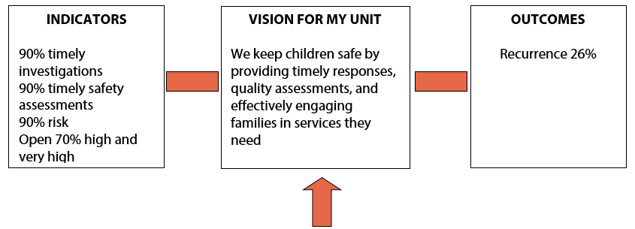
Layer 1
P. Guide
76
Notes:
Refer to participant guide page 75.
Indicators and outcomes are things you can often track in SafeMeasures. Outcomes are the impact on families; indicators are processes the unit controls.

Slide 66
Layer 2
P. Guide
76
Notes:
Layer 2 is like the family’s FSNA. You can decide your priorities in several ways:
What is in your county SIP? To what part of it can you contribute?
Look through SafeMeasures and see which areas lag behind others.
Talk to your manager about directions he/she would like to see you go.
Do not pick more than three! (One or two is fine. Better to work on one and succeed than do four or five and get stuck!)

Slide 67
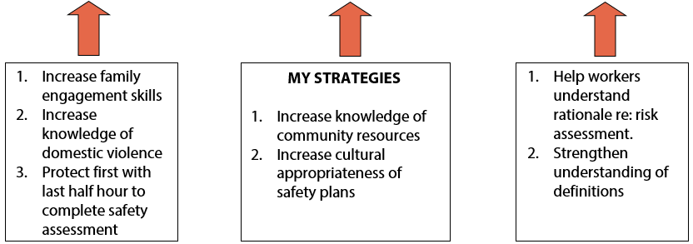
Layer 3
P. Guide
76
Notes:
Layer 3 is like the family’s case plan objectives. For each priority area, think about what it would take to make positive change.

Slide 68
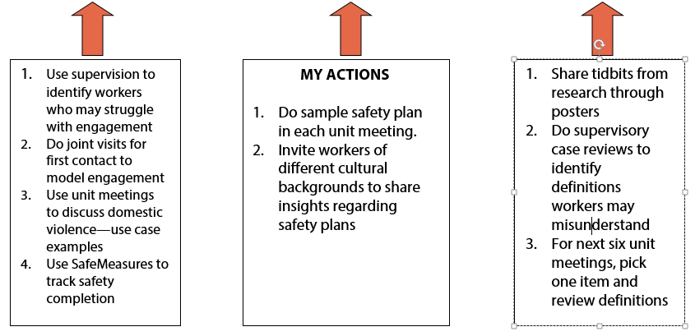
Layer 4
P. Guide
76
Notes:
Layer 4 is like the family’s services. These are concrete things you will do on a day-to-day basis. As with families, don’t give yourself so much to do that you cannot succeed. Ask your manager to help prioritize with you.

Slide 69
My Unit’s Plan
Notes:
Note to trainer: Refer participants to the blank plan in the workbook on p. 77.
Take a few minutes. Think of a vision for how you want your unit to function two years from now.
Then think of at least one priority process or outcome that will help get you there. For that priority, think of at least one strategy that will get you there. For that strategy, think of at least one specific, concrete action you can take to start the journey beginning this week.

Slide 70
Begin Your Plan
P. Guide
77
Vision
One indicator
One outcome
One priority
One or two strategies
One or two actions
Notes:
The goal is to begin the plan today.

Slide 71
Debrief
Notes:
Note to trainer: Ask some volunteers to share their mission/priority/strategy and action.
Close the exercise by asking participants to write their names and phone numbers or email addresses on Post-it notes, along with one action each person is commited to doing. Each participant should exchange his/her Post-it note with someone from another county (or, if all from the same county, another unit) and designate one of the pair to call the other one week from today to ask about the action to which he/she committed. Ask participants to get out their calendars or smart phones and put the date and task on their calendars.

Slide 72
Thank you!
Notes:
Note to trainer: Conclude by going around the room and asking each person to state his/her most significant “take away” from the session.
Thank everyone for their participation.

Slide 73
Narrative
Common Approach
Suggested Approach
Chronological narrative
He said/she said
Unresolved contradictions
Missing links
Summary sections
Screener narrative
Investigation summary
Court reports
Template contact note
Explain item scores
Include family engagement efforts
Omit unnecessary information
Notes:
Note: Hyperlink takes you back to Slide 46, the basic questions.

